Slide 1
Micro-internship: Extracting Insights from Data - FAMU DeLuca

Slide 2

Agenda
Exploratory Data Analysis
Questions answered through visualizations
Visualizations
Questions/Feedback

Slide 3
Metadata of the dataset
Date: The date when litter accumulation was recorded or measured.
DeviceID: A unique identifier for the litter collection device.
Org: The organization or entity responsible for the litter collection.
Site: The location or site where the litter collection device is installed.
LitterRecyclablesWeightLb: The weight of recyclable litter collected in pounds.
LitterTrashWeightLb: The weight of non-recyclable (trash) litter collected in pounds.
DebrisRecyclablesWeightLb: The weight of recyclable debris collected in pounds.
DebrisTrashWeightLb: The weight of non-recyclable (trash) debris collected in pounds.
dataCards: Possibly a count or identifier for data cards associated with the litter collection.
City: The city where the litter collection site is located.
County: The county where the litter collection site is located.
device: Possibly another identifier or category for the type of device used for litter collection.
lon: The longitude coordinate of the litter collection site.
lat: The latitude coordinate of the litter collection site.

Slide 4
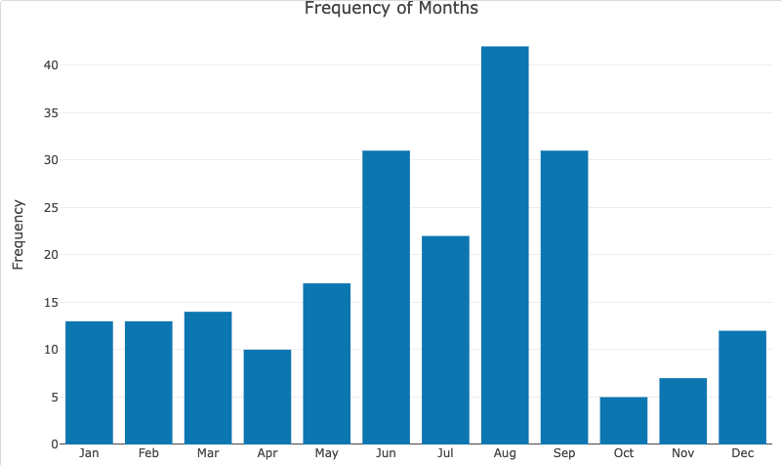
Waste Generation by Month

Slide 5
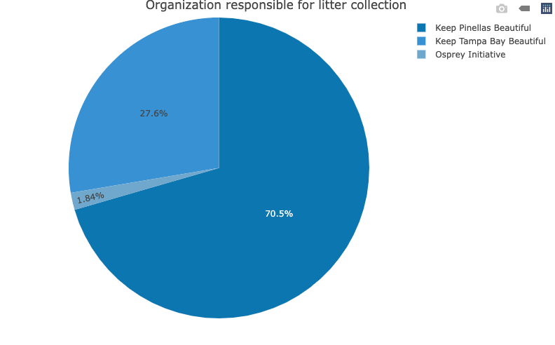
Organization responsible for litter collection

Slide 6
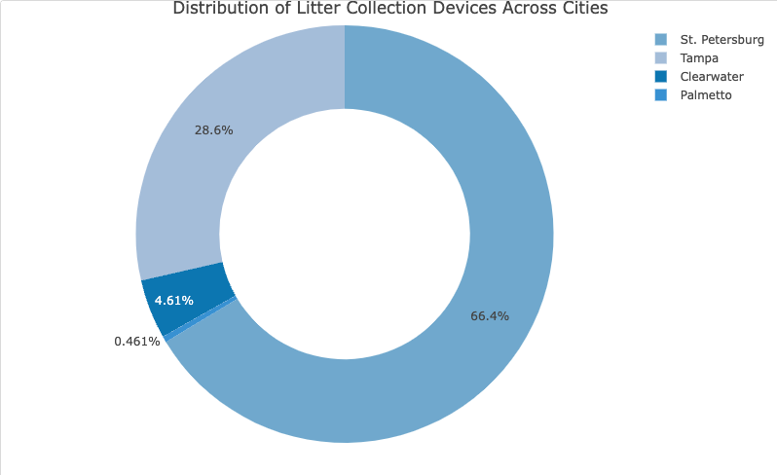
Distribution of Litter Collection Devices Across Cities

Slide 7
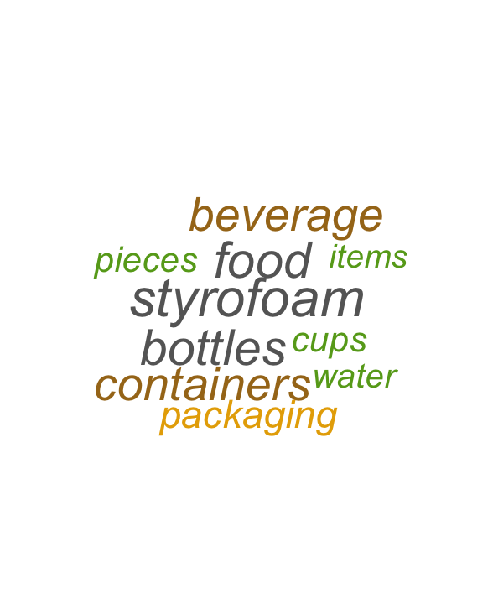
Top 10 items that are found in the marine debris

Slide 8
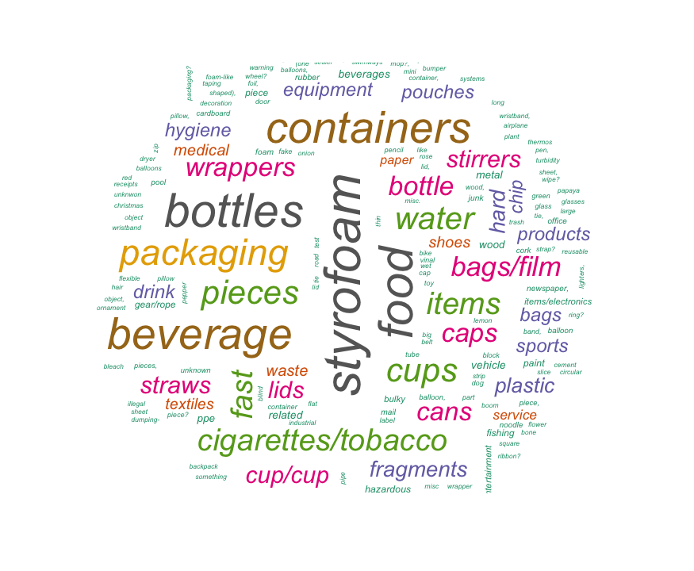
Items found in the marine debris

Slide 9
Question: Are different devices better/ more effective at capturing certain categories (i.e maybe sea bins capture an abundance of cig butts)

Slide 10


Solution
Waste analysis
Device analysis

Slide 11
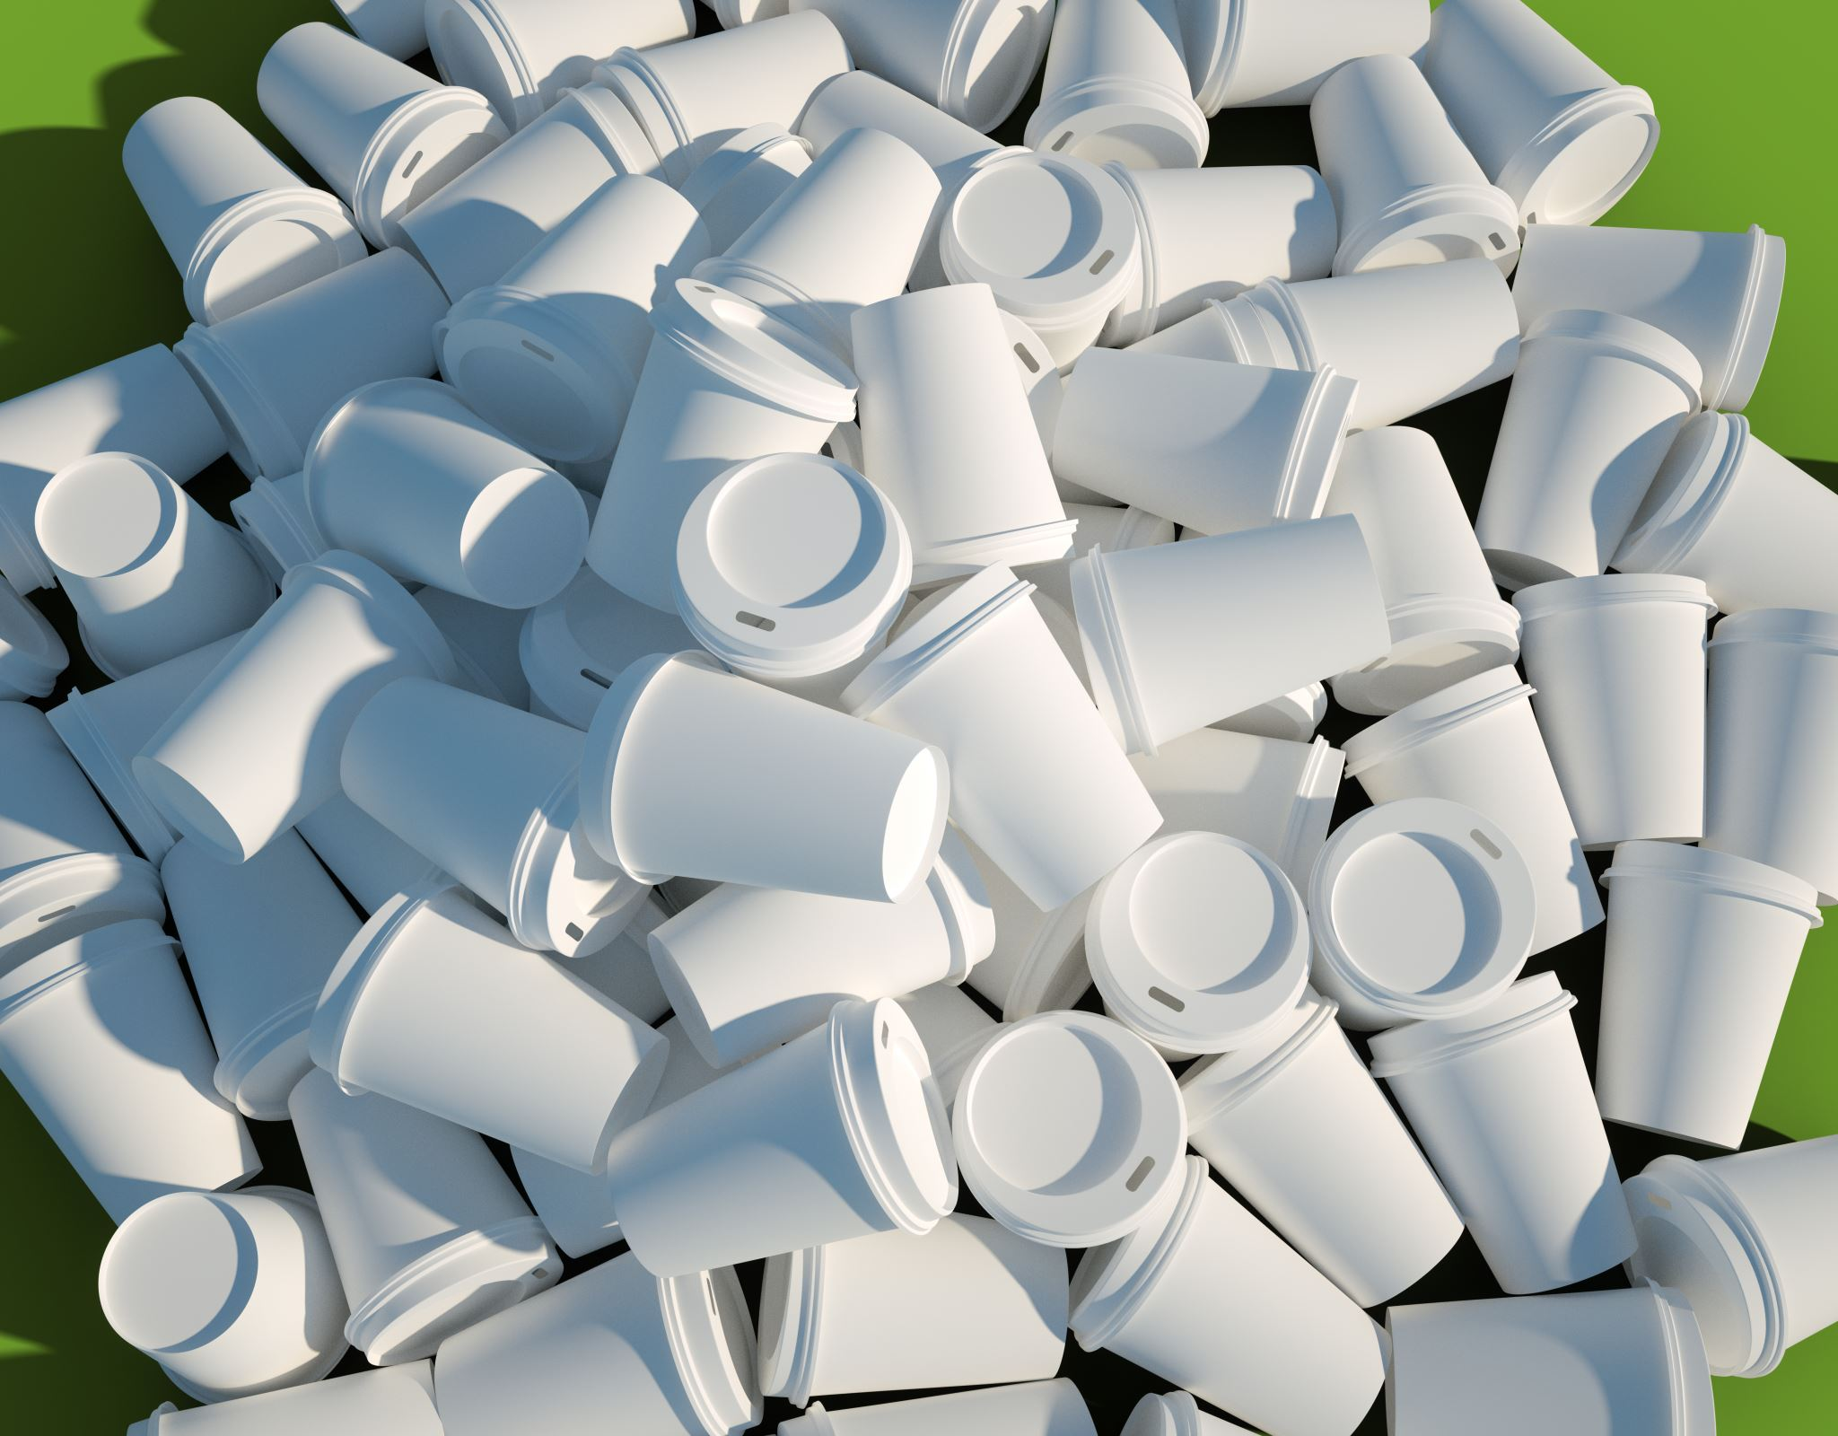
Waste analysis

Slide 12
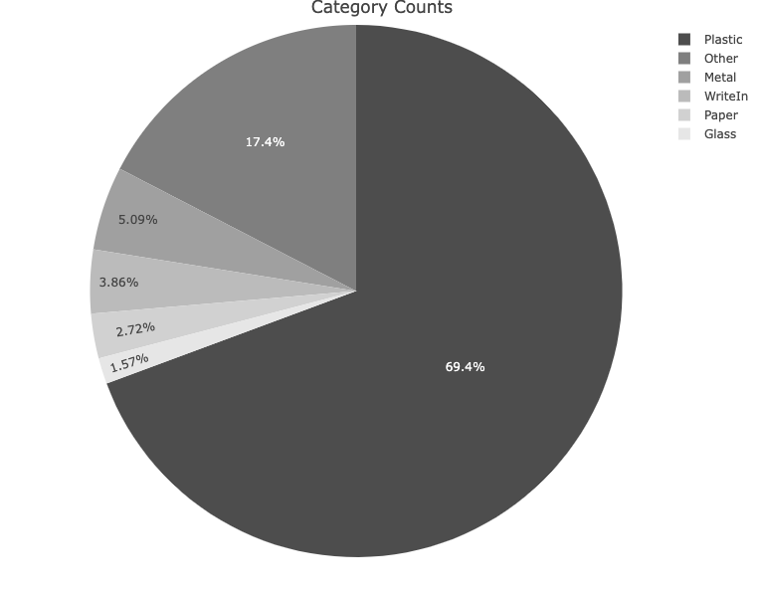
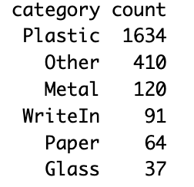
Category Counts: Distribution of Waste Categories

Slide 13
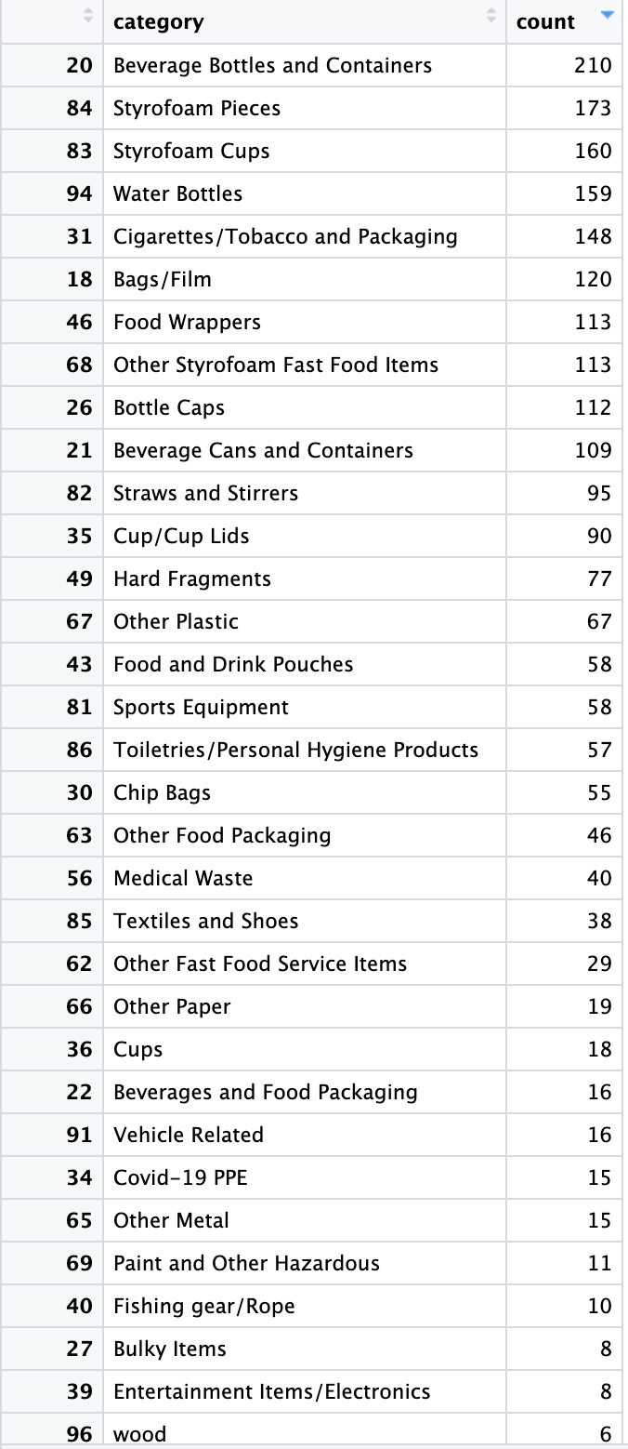
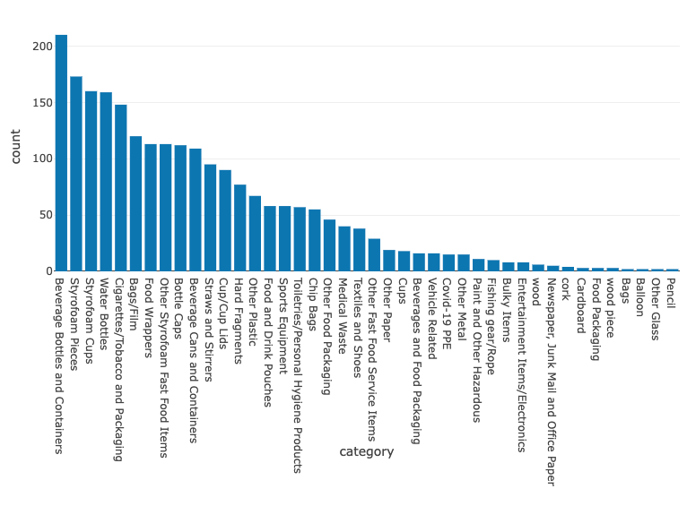
Sub-category Counts: Distribution of Waste Categories

Slide 14
Questions: What are the various types of waste captured by the devices? Which devices are effective for different categories of waste?

Slide 15
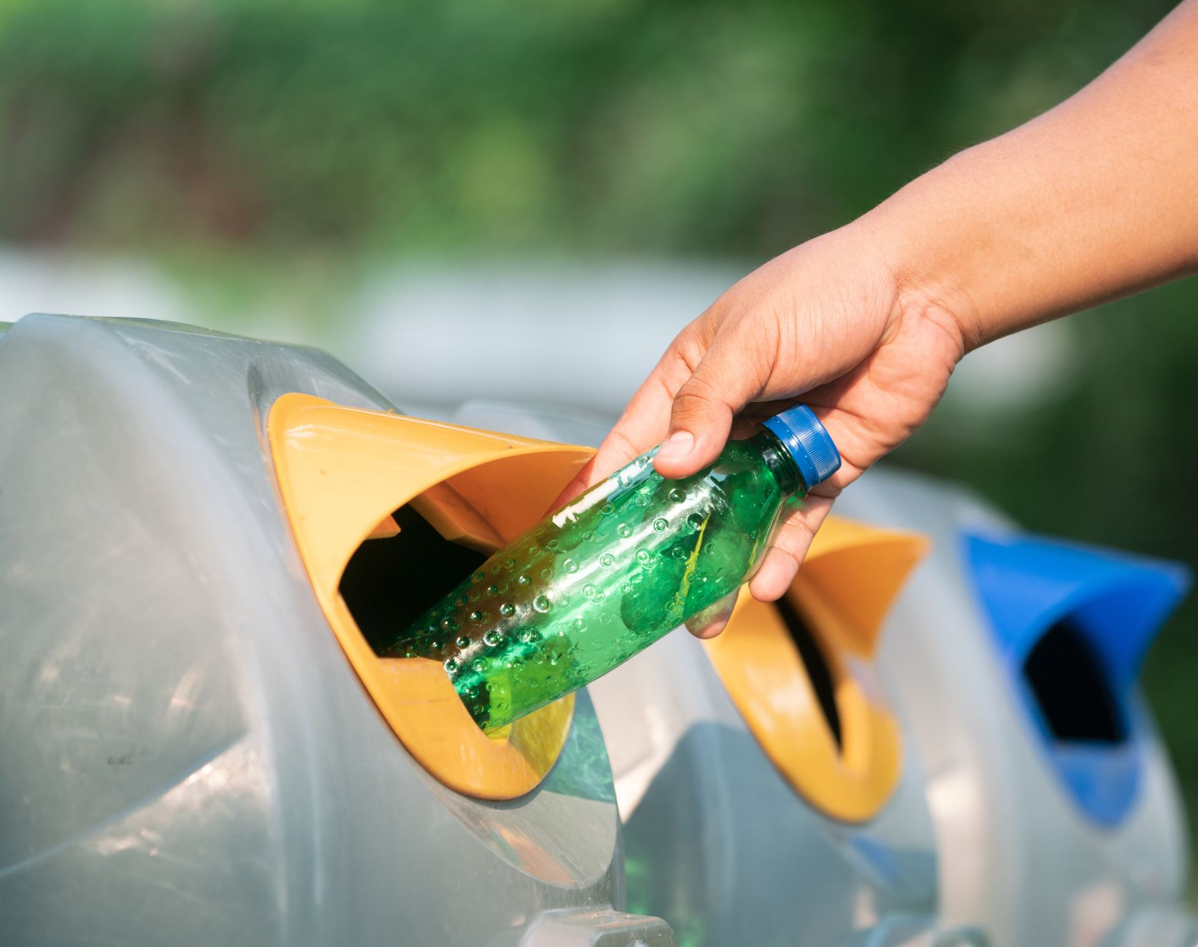
Device Analysis

Slide 16
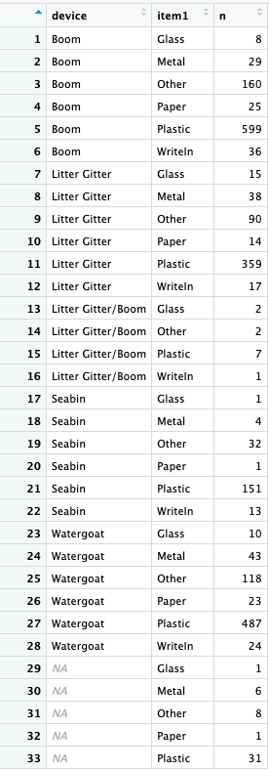
Type of wastes collected in every device

Slide 17
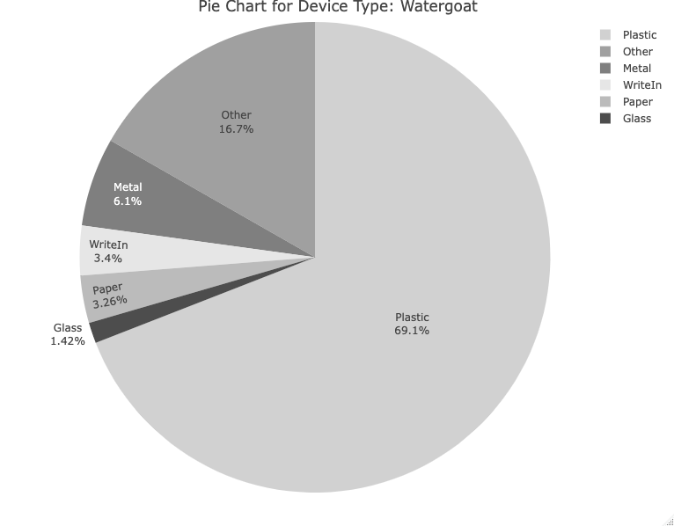
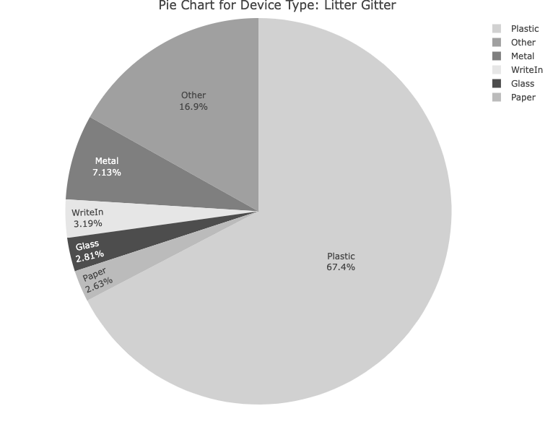
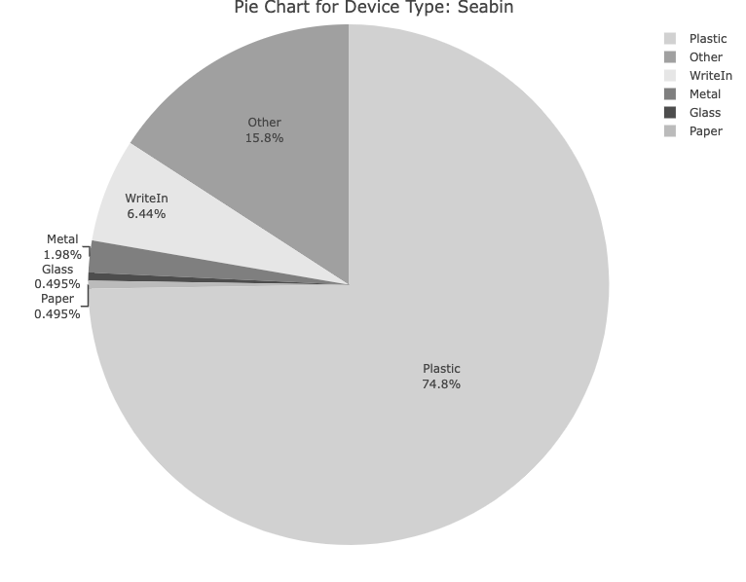
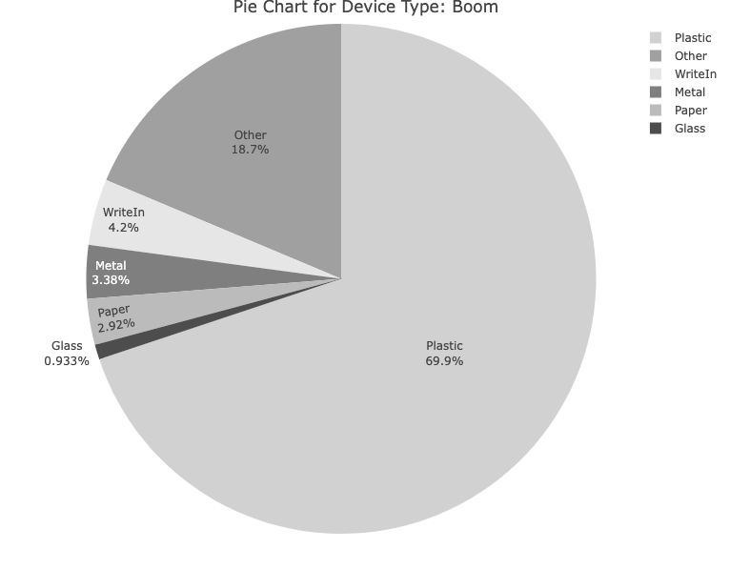

Slide 18
Table #1: Count of different categories for each device type
Device Type | Category | Plastic | Metal | WriteIn | Glass | Paper | Other
Boom | 599 | 29 | 36 | 8 | 25 | 160
Watergoat | 487 | 43 | 24 | 10 | 23 | 118
Seabin | 151 | 4 | 13 | 1 | 1 | 32
Litter Gitter | 359 | 38 | 17 | 15 | 14 | 90
Litter Gitter/Boom | 7 | 0 | 1 | 2 | 0 | 2
Table #2: Proportion of each category for each device type
Device Type | Category | Plastic | Metal | WriteIn | Glass | Paper | Other
Boom | 25.42 | 1.23 | 1.53 | 0.34 | 1.06 | 6.79
Watergoat | 20.67 | 1.83 | 1.02 | 0.42 | 0.98 | 5.01
Seabin | 6.41 | 0.17 | 0.55 | 0.04 | 0.04 | 1.36
Litter Gitter | 15.24 | 1.61 | 0.72 | 0.64 | 0.59 | 3.82
Litter Gitter/Boom | 0.3 | 0 | 0.04 | 0.08 | 0 | 0.08

Slide 19
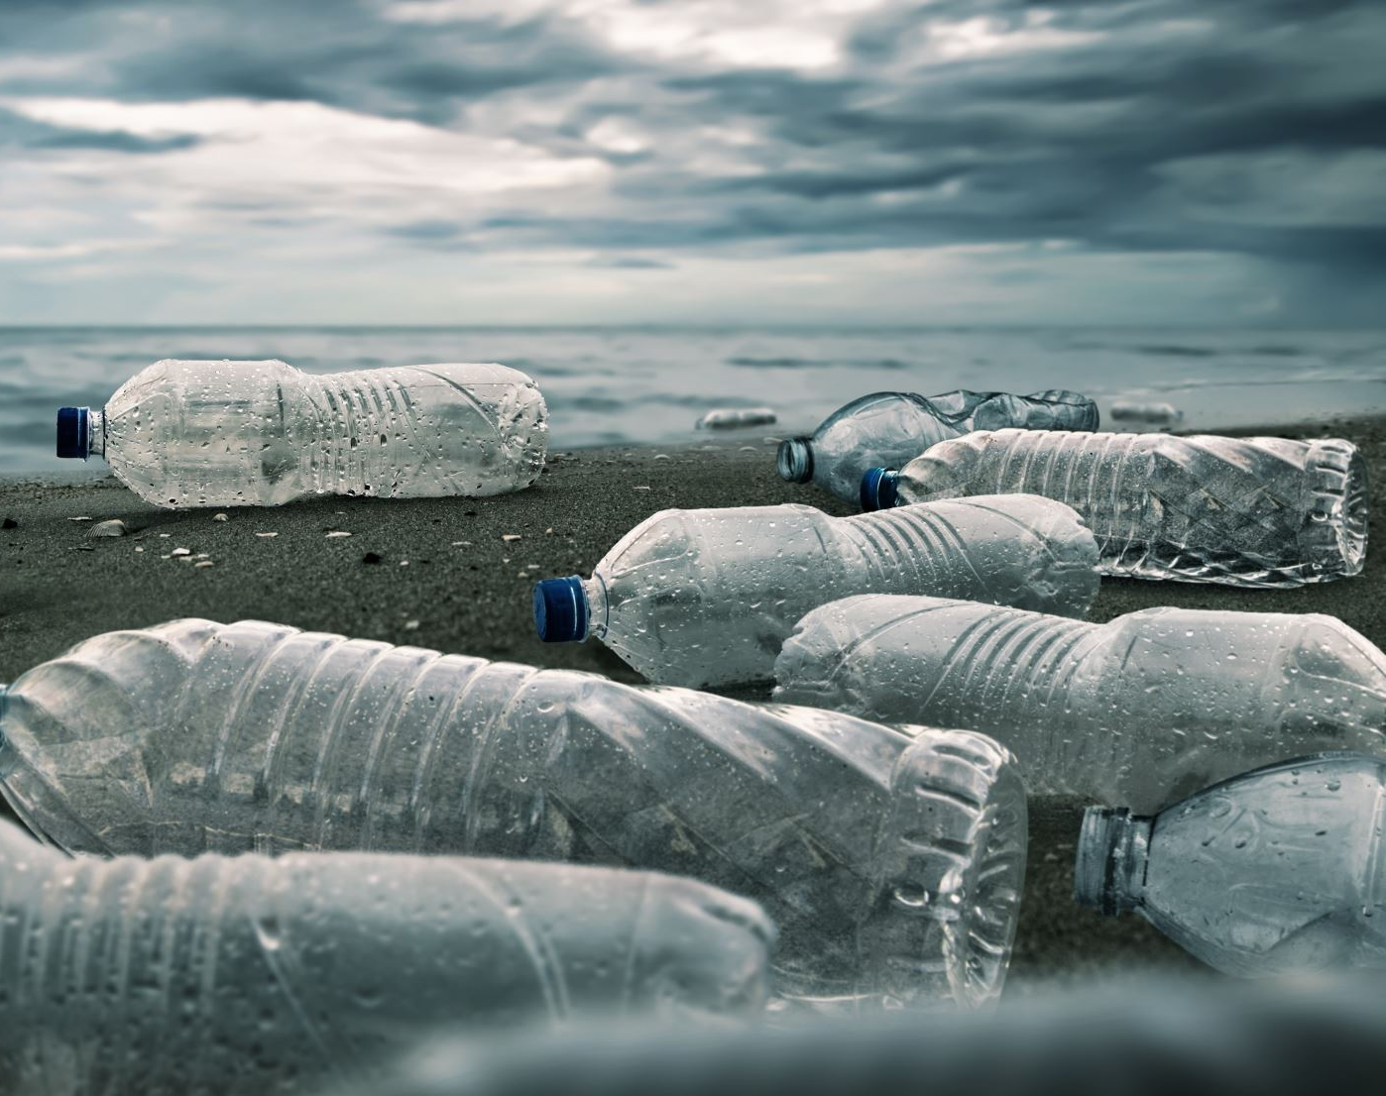
Insights from Topic Modeling

Slide 20
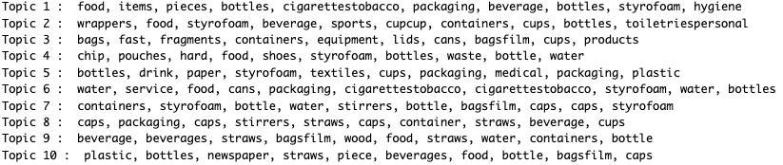
Tackling Waste and Promoting Sustainability

Slide 21
Strategic Waste Management Solutions
Topic | Issues to be addressed | Solution
Topic 1 : Food, Items, Pieces, Bottles, Cigarettestobacco, Packaging, Beverage, Bottles, Styrofoam, Hygiene | Food packaging waste | Proper disposal of cigarette/tobacco packaging. Promoting hygiene practices and responsible waste management in public spaces
Topic 2 : Wrappers, Food, Styrofoam, Beverage, Sports, Cupcup, Containers, Cups, Bottles, Toiletriespersonal | Single-use wrappers alternatives to styrofoam waste | Recycling or sustainable disposal options for sports equipment
Topic 3 : Bags, Fast, Fragments, Containers, Equipment, Lids, Cans, Bagsfilm, Cups, Products | Reducing plastic bag usage fast food waste | Promoting reusable alternatives initiatives for better waste management in the industry
Topic 4 : Chip, Pouches, Hard, Food, Shoes, Styrofoam, Bottles, Waste, Bottle, Water | Non-recyclable chip packets hard food waste | Composting to reduce environmental impact
Topic 5 : Bottles, Drink, Paper, Styrofoam, Textiles, Cups, Packaging, Medical, Packaging, Plastic | Improper disposal of beverage bottles, recycling paper, textile waste, medical waste | Strategies to improve proper disposal methods
Topic 6 : Water, Service, Food, Cans, Packaging, Cigarettestobacco, Cigarettestobacco, Styrofoam, Water, Bottles | Plastic bottles service waste such as disposable cutlery and packaging | Reusable bottles
Topic 7 : Containers, Styrofoam, Bottle, Water, Stirrers, Bottle, Bagsfilm, Caps, Caps, Styrofoam | Single-use containers | Resusable containers proper recycling
Topic 8 : Caps, Packaging, Caps, Stirrers, Straws, Caps, Container, Straws, Beverage, Cups | Plastic caps, single-use stirrers, straws | Resusable containers proper recycling
Topic 9 : Beverage, Beverages, Straws, Bagsfilm, Wood, Food, Straws, Water, Containers, Bottle | Wooden disposable products plastic bags/film waste | Reusable bags
Topic 10 : Plastic, Bottles, Newspaper, Straws, Piece, Beverages, Food, Bottle, Bagsfilm, Caps | Plastic straw waste | Bottle deposit schemes
By addressing these specific waste management issues identified through the topic modeling analysis, organizations like Keep Pinellas Beautiful can develop targeted solutions, awareness campaigns, recycling initiatives, and collaborations to tackle the most significant waste challenges in their community.

Slide 22
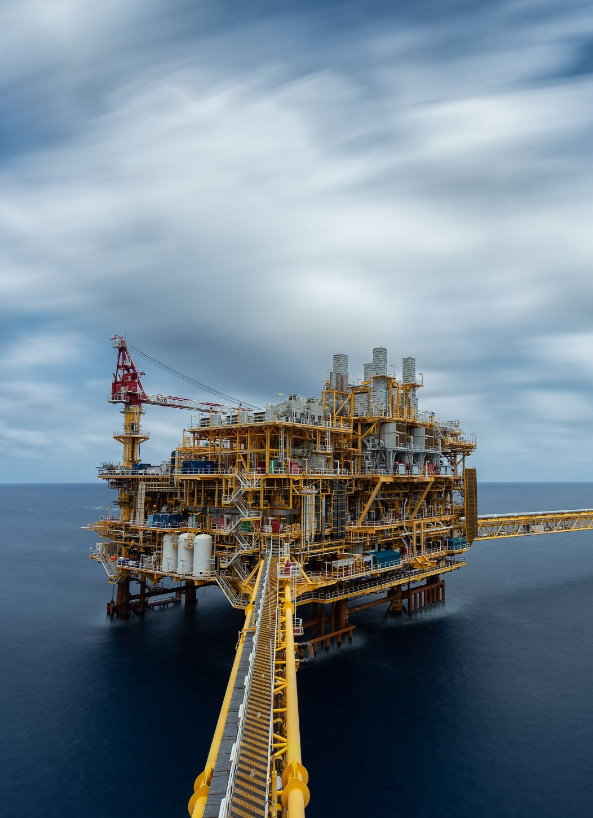
Future work
More analysis on topic modeling
Is there a relationship between land use around the location/watershed of the trash collection device and the category of trash collected? (Analysis on land use data)
Is there a relationship between the weather of the day and the amount waste generated? (Time series analysis)

